Slide 1




Datasets and AI course
University of Sussex

Slide 2
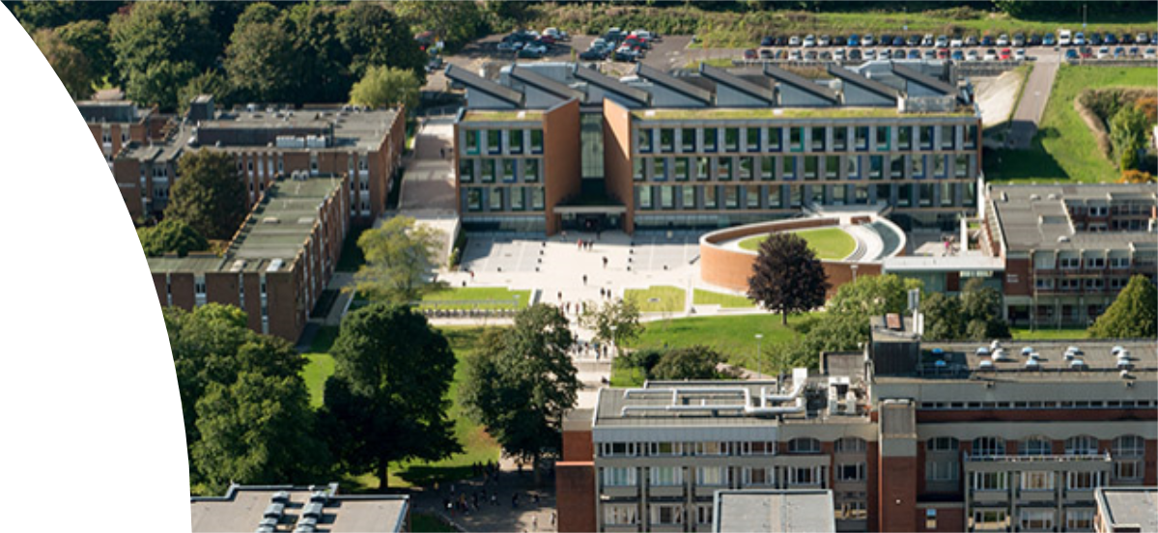
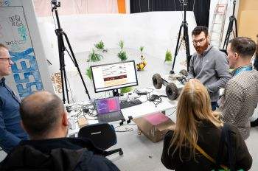
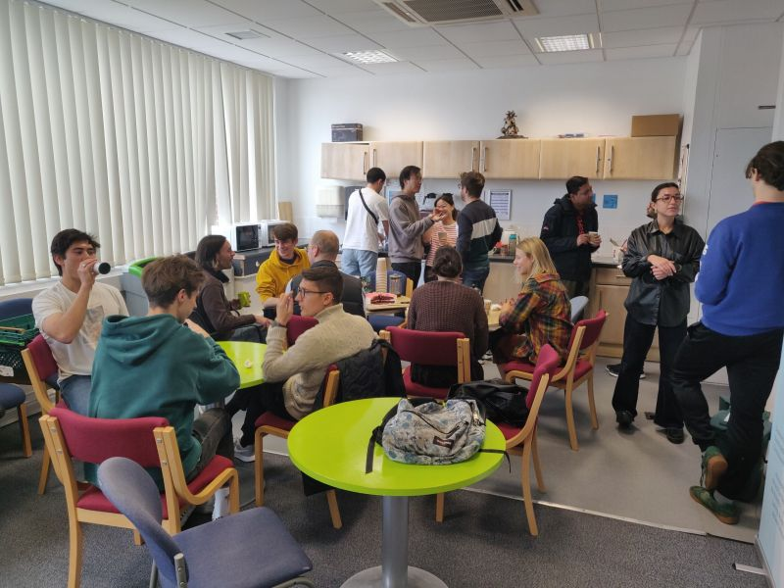
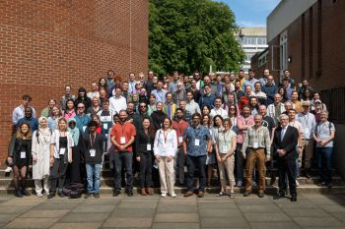
Who are we
•AI centre of research at the University of Sussex
•One of the first UK universities to teach AI
•Home of many doctoral training centres
•Industrial links

Slide 3
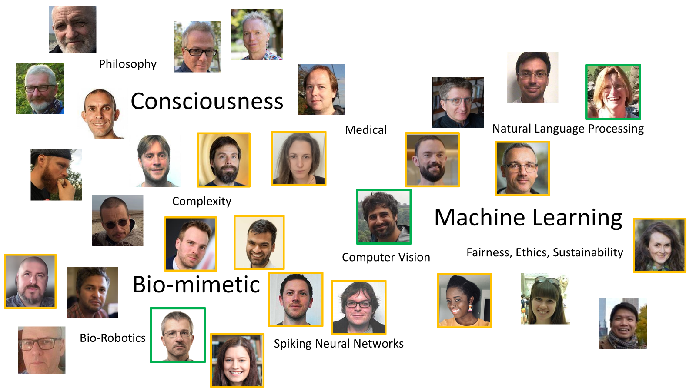

Slide 4
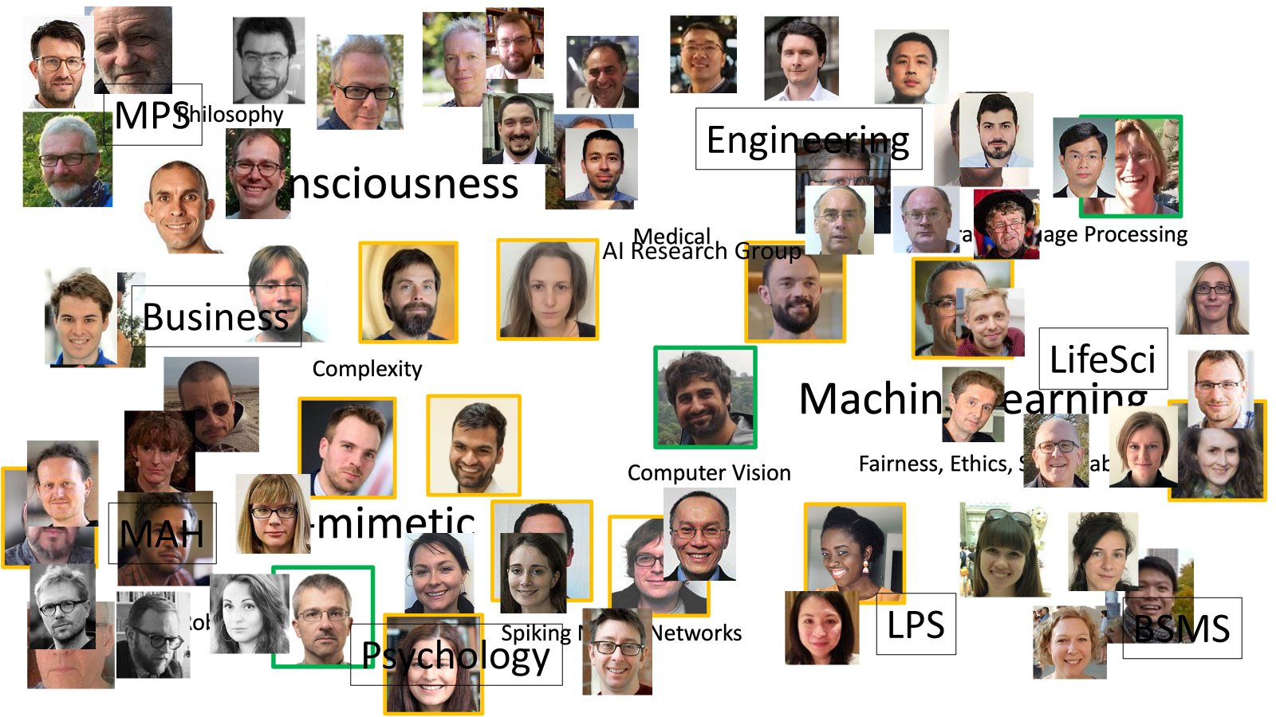

Slide 5


Slide 6
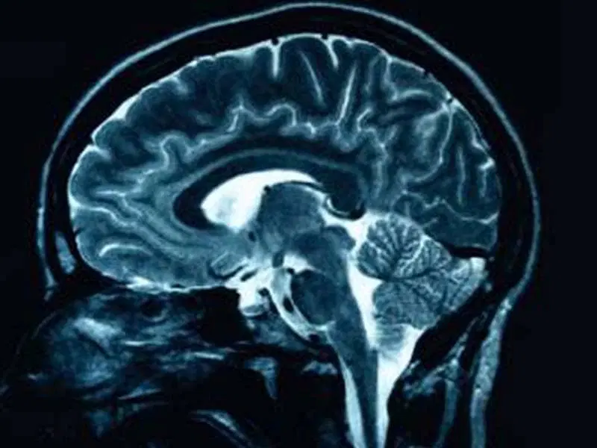
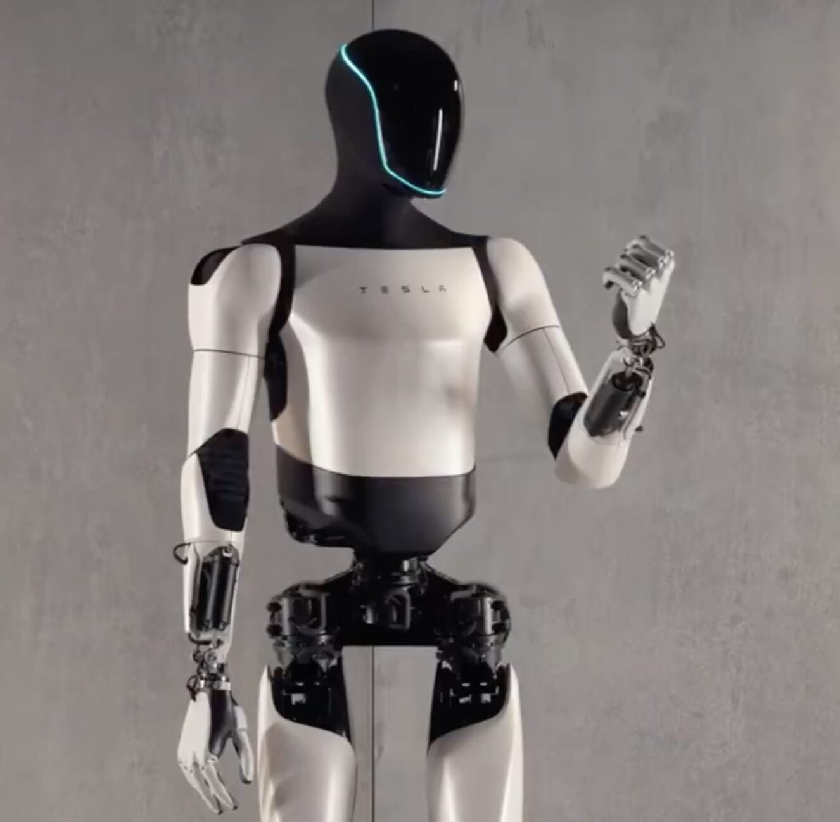

Artificial Intelligence and our world

Slide 7
What is machine learning
A subset of AI involving computer programmes, often referred to as models
Models are trained to perform some sort of task
Does not require specific program instructions
Learns patterns in data (not always viable by human-written algorithms)
Notes:
ho a model differs from algorithm

Slide 8
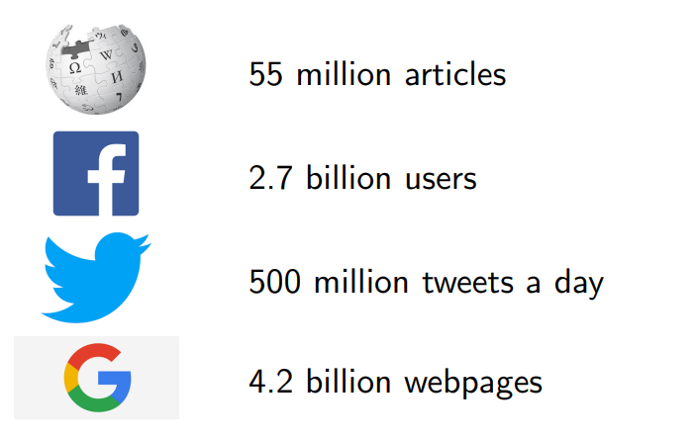
Why is machine learning interesting/relevant
There is so much data!
You likely interact with machine learning on a daily basis

Slide 9
AI and data
Data exists -> model trains -> AI does something
Every second 24,000 gigabytes is uploaded to the internet

Slide 10
What is that data
3,400,000 emails are sent
740,741 are WhatsApp messages
68,542 are Google searches
54,977 are Facebook posts
7,252 tweets are sent
125,406 YouTube videos are viewed

Slide 11
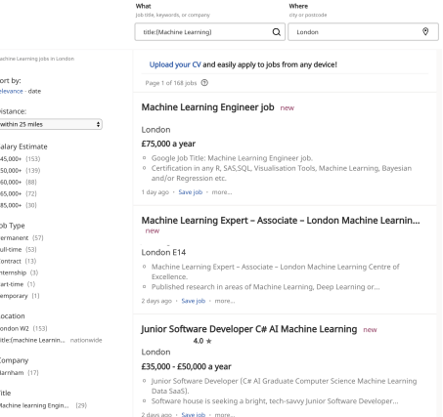
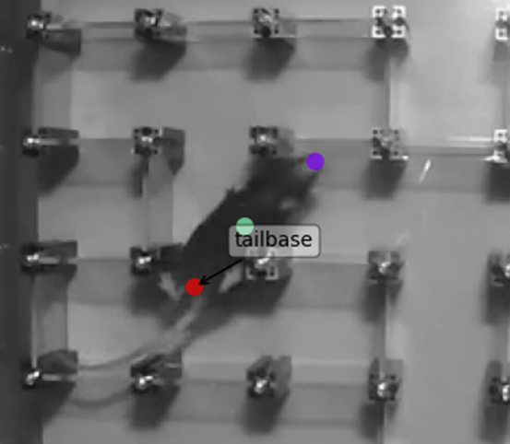
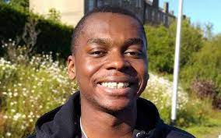
Why should you care?
Being able to classify or predict data is a huge part of science and industry
Can help do the science for you!
Money in ML is quite good generally around the world
Oluwaseyi Jesusanmi
Life Science PhD student

Slide 12
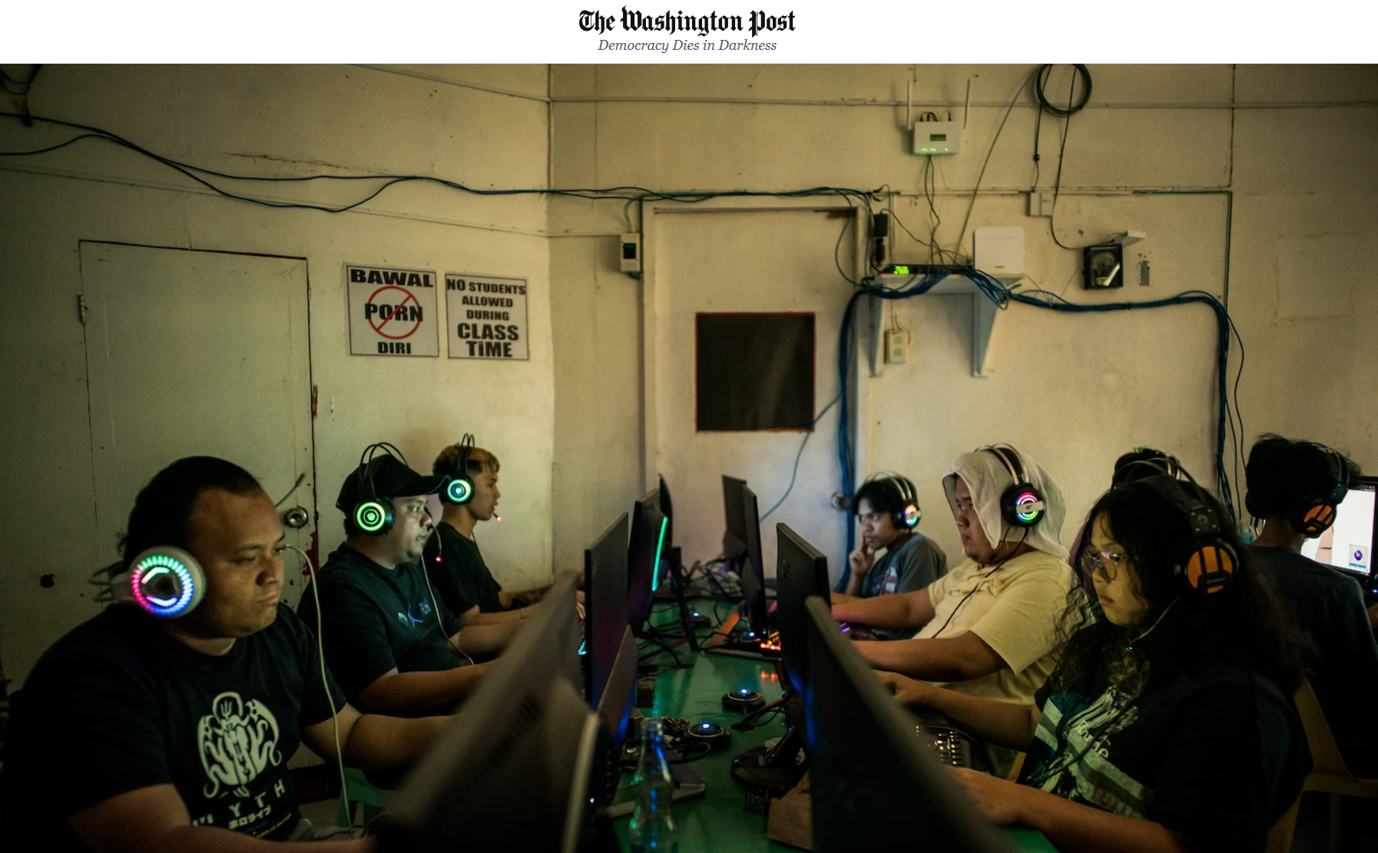
Useful for ML but comes with problems
This data still needs labelling which is time consuming
Many companies outsource this overseas where wages are cheaper
Material mentally damaging

Slide 13
Commitment to open science
So much data is behind a paywall, which moves AI into a scary place! What if only the best AIs belong to large companies who do not have to publish their methods or ethics…
By making datasets and models open source, others can learn from, benefit from and improve upon your original creation.

Slide 14

UN AI policy
AI-related capacity-building for developing countries with a focus on the “bottom billion”;
Supporting broader stakeholder engagement and knowledge exchange within and outside the United Nations system on AI; and
Promoting the ethical development and application of AI technologies for the public good.
“ensuring no one is left behind”

Slide 15
9.a “Artificial intelligence should be addressed in an ambitious and holistic manner, promoting the use of artificial intelligence as a tool in the implementation of the Goals, while also addressing emerging ethical and human rights, decent work, technical and socioeconomic challenges;”
A United Nations system-wide strategic approach and road map for supporting capacity development on artificial intelligence

Slide 16
9.c “Artificial intelligence-related capacity-building programming should balance economic, social and environmental goals: reducing inequalities and ensuring equal access to opportunities, promoting productive transformation of the economy and protecting the natural environment. Such a process generates social justice within and between generations, sustainable development, peace and prosperity;”
A United Nations system-wide strategic approach and road map for supporting capacity development on artificial intelligence

Slide 17
9.d “Artificial intelligence-related capacity-building programming should gather diverse perspectives on the benefits and risks of artificial intelligence technologies and take into consideration the needs of all people, including those at risk of being left behind, especially those who are marginalized and vulnerable. People and particularly those farthest behind, including women and girls, should be at the centre of all artificial intelligence-related capacity-building programming and decision-making processes; “
A United Nations system-wide strategic approach and road map for supporting capacity development on artificial intelligence

Slide 18
9.j “All artificial intelligence-related programming by United Nations entities should ensure that a due process was followed to select artificial intelligence as the appropriate tool to deliver innovative and cost-effective solutions for achieving the Goals. In this way, the United Nations would ensure that alternative technological solutions were considered and that artificial intelligence was used because it was appropriate. “
A United Nations system-wide strategic approach and road map for supporting capacity development on artificial intelligence

Slide 19
The volunteers

Slide 20
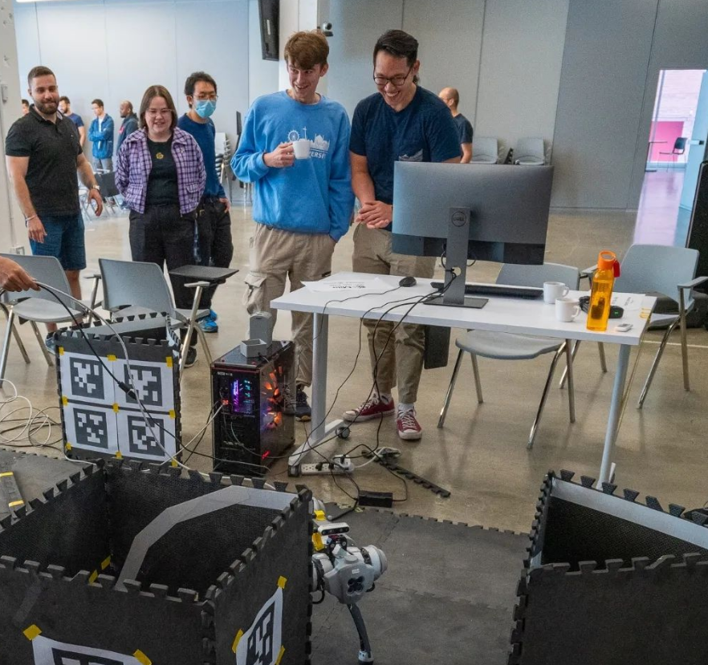
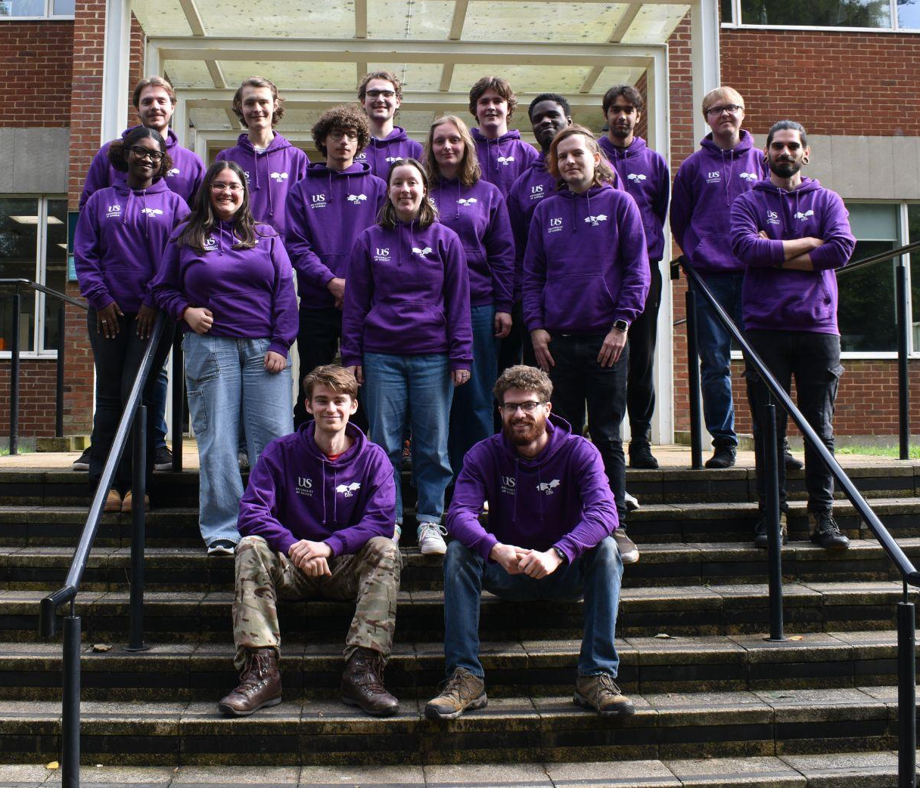
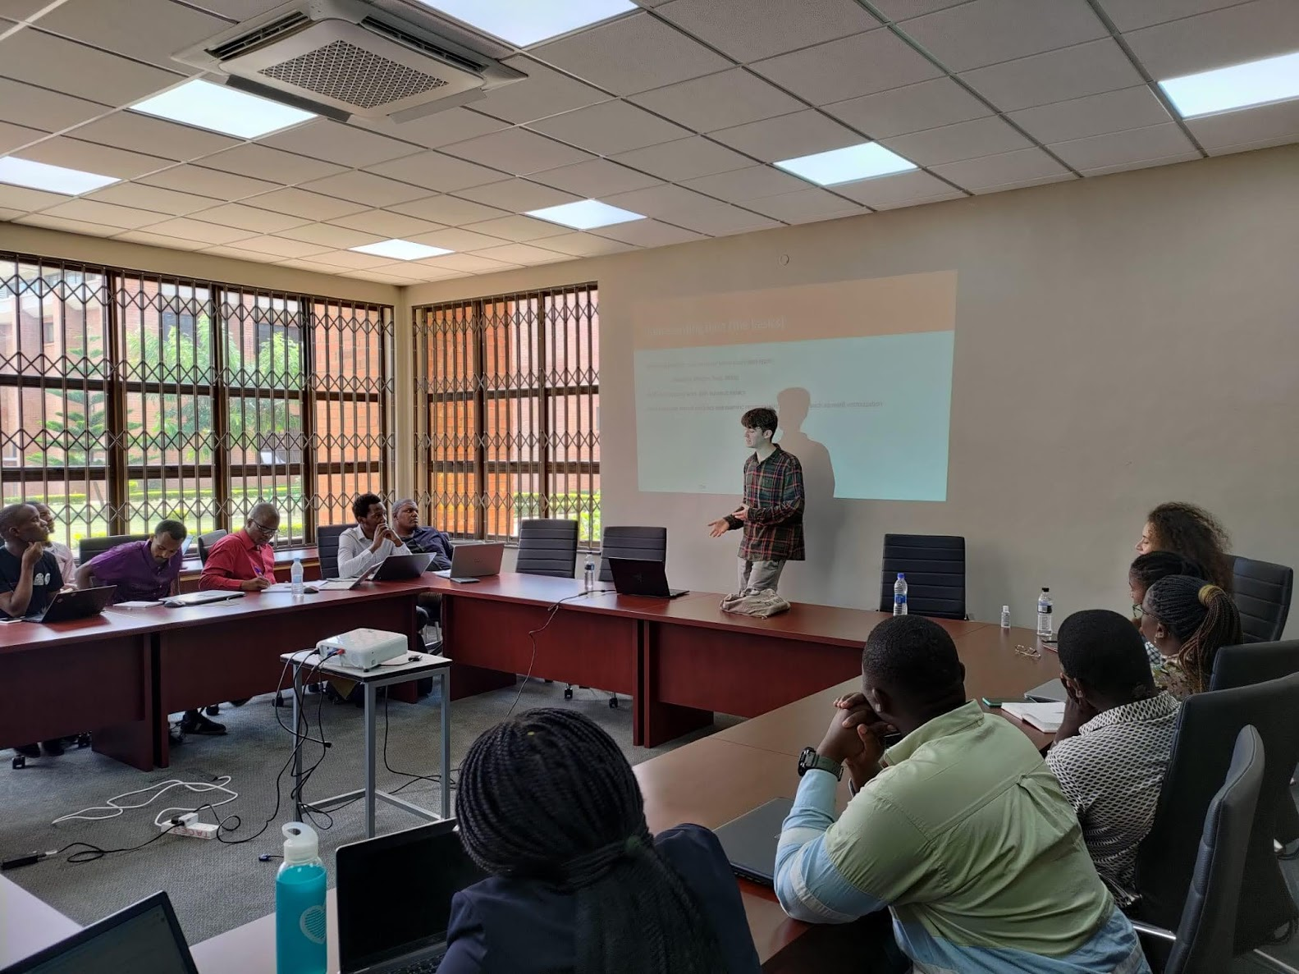
Dexter Shepherd
Third year PhD in AI and Robotics
Research in tactile sensors for robotic locomotion
Head of student mentoring for the school of Engineering and Informatics
Second time in Malawi!

Slide 21
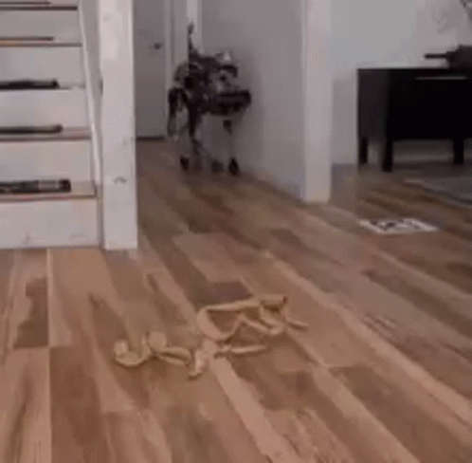
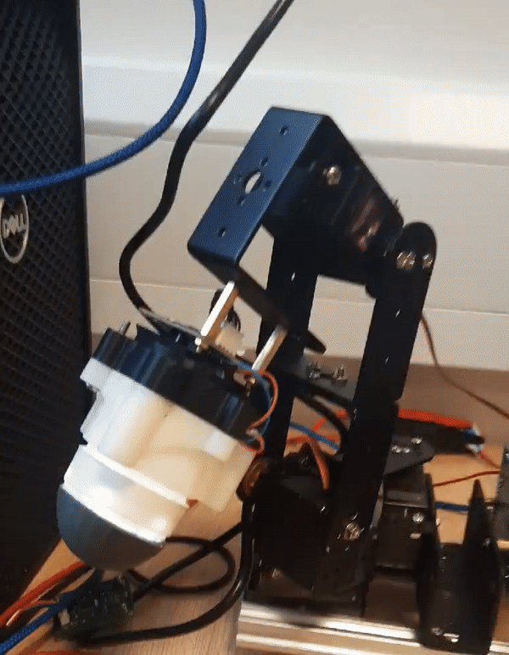
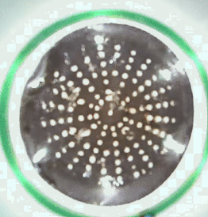
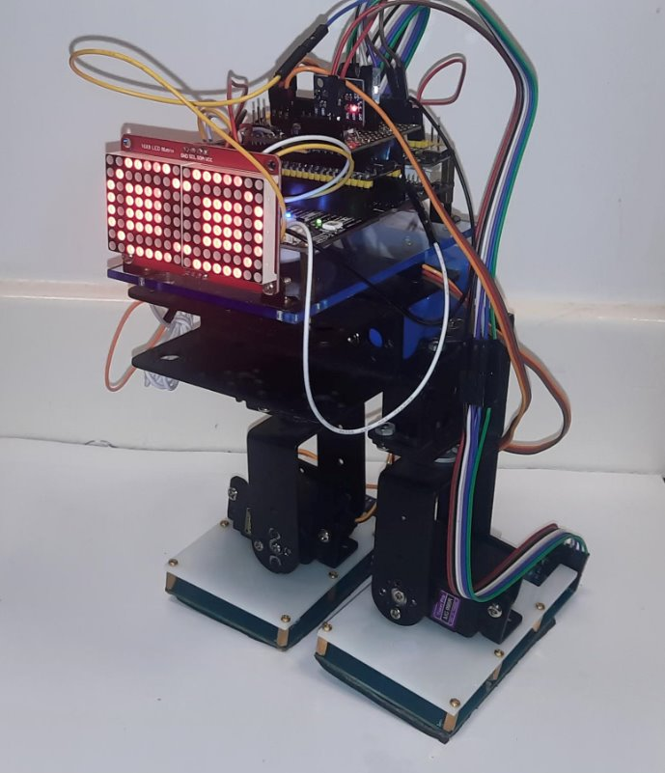
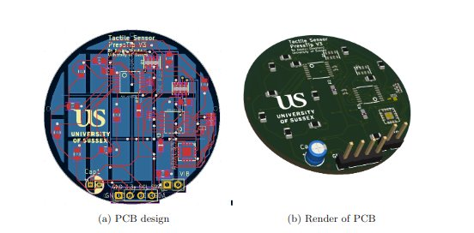
My research
Detecting ground properties using biomimetic sensors to improve locomotion

Slide 22
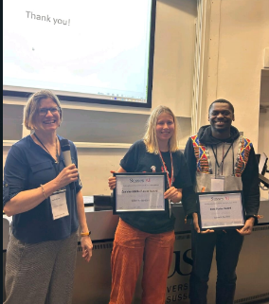
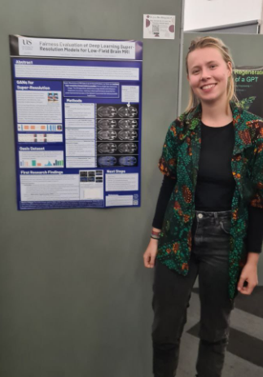

Paula Seidler
First year PhD in AI and Computer Vision
Research in finding better loss functions/metrics for images
Lab tutor at the university for AI modules
Ran machine learning workshops as a student mentor
Notes:
Pal picture/jra poster pic

Slide 23
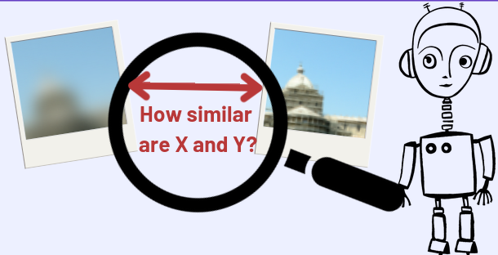
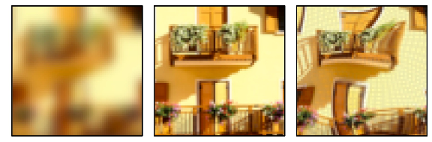
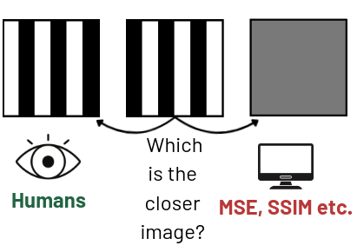
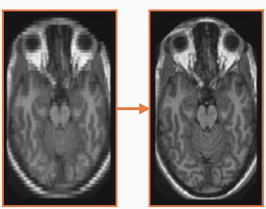

My research
Metrics are fundamental for training + evaluating AI models
As loss functions, they define what the model learns
I try to find image metrics that better align with human perception!

Slide 24
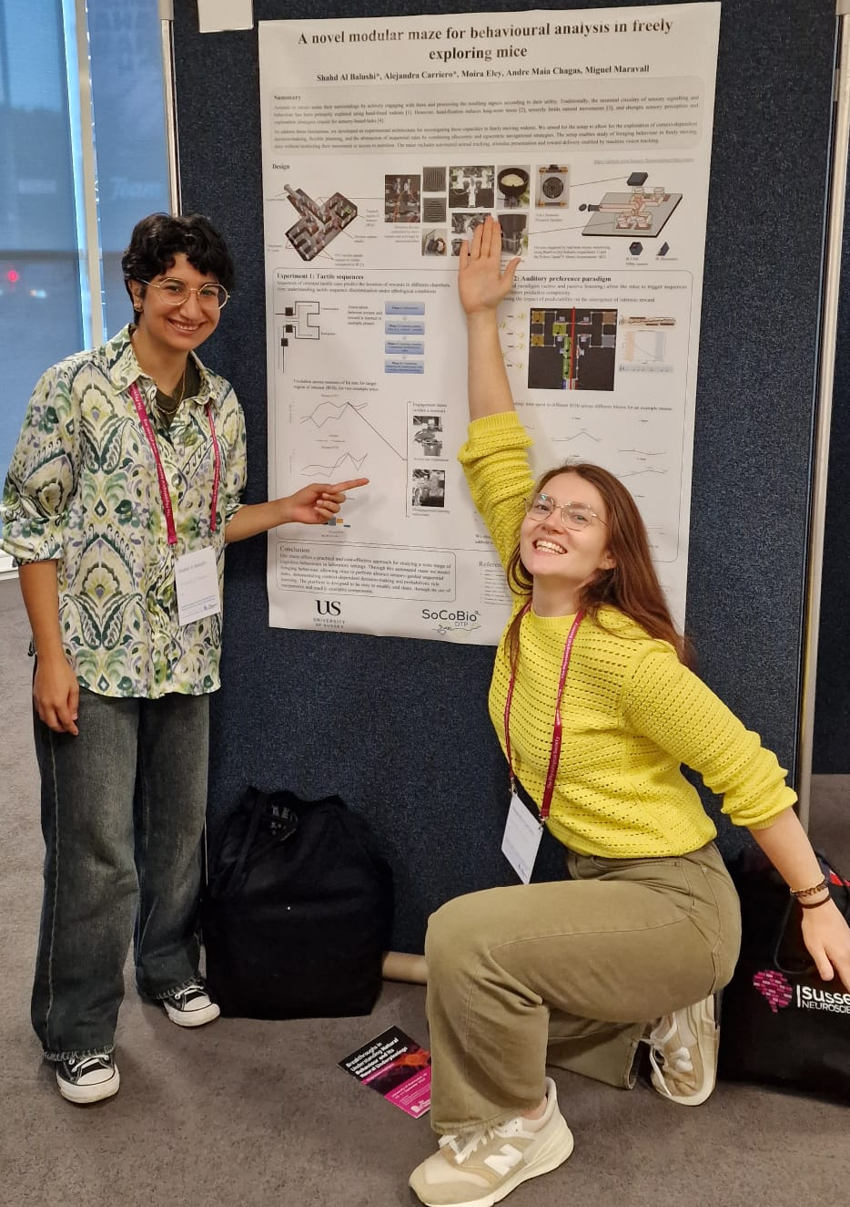
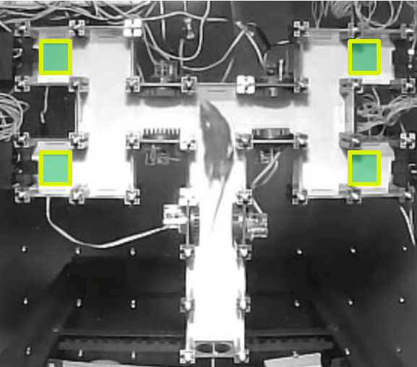
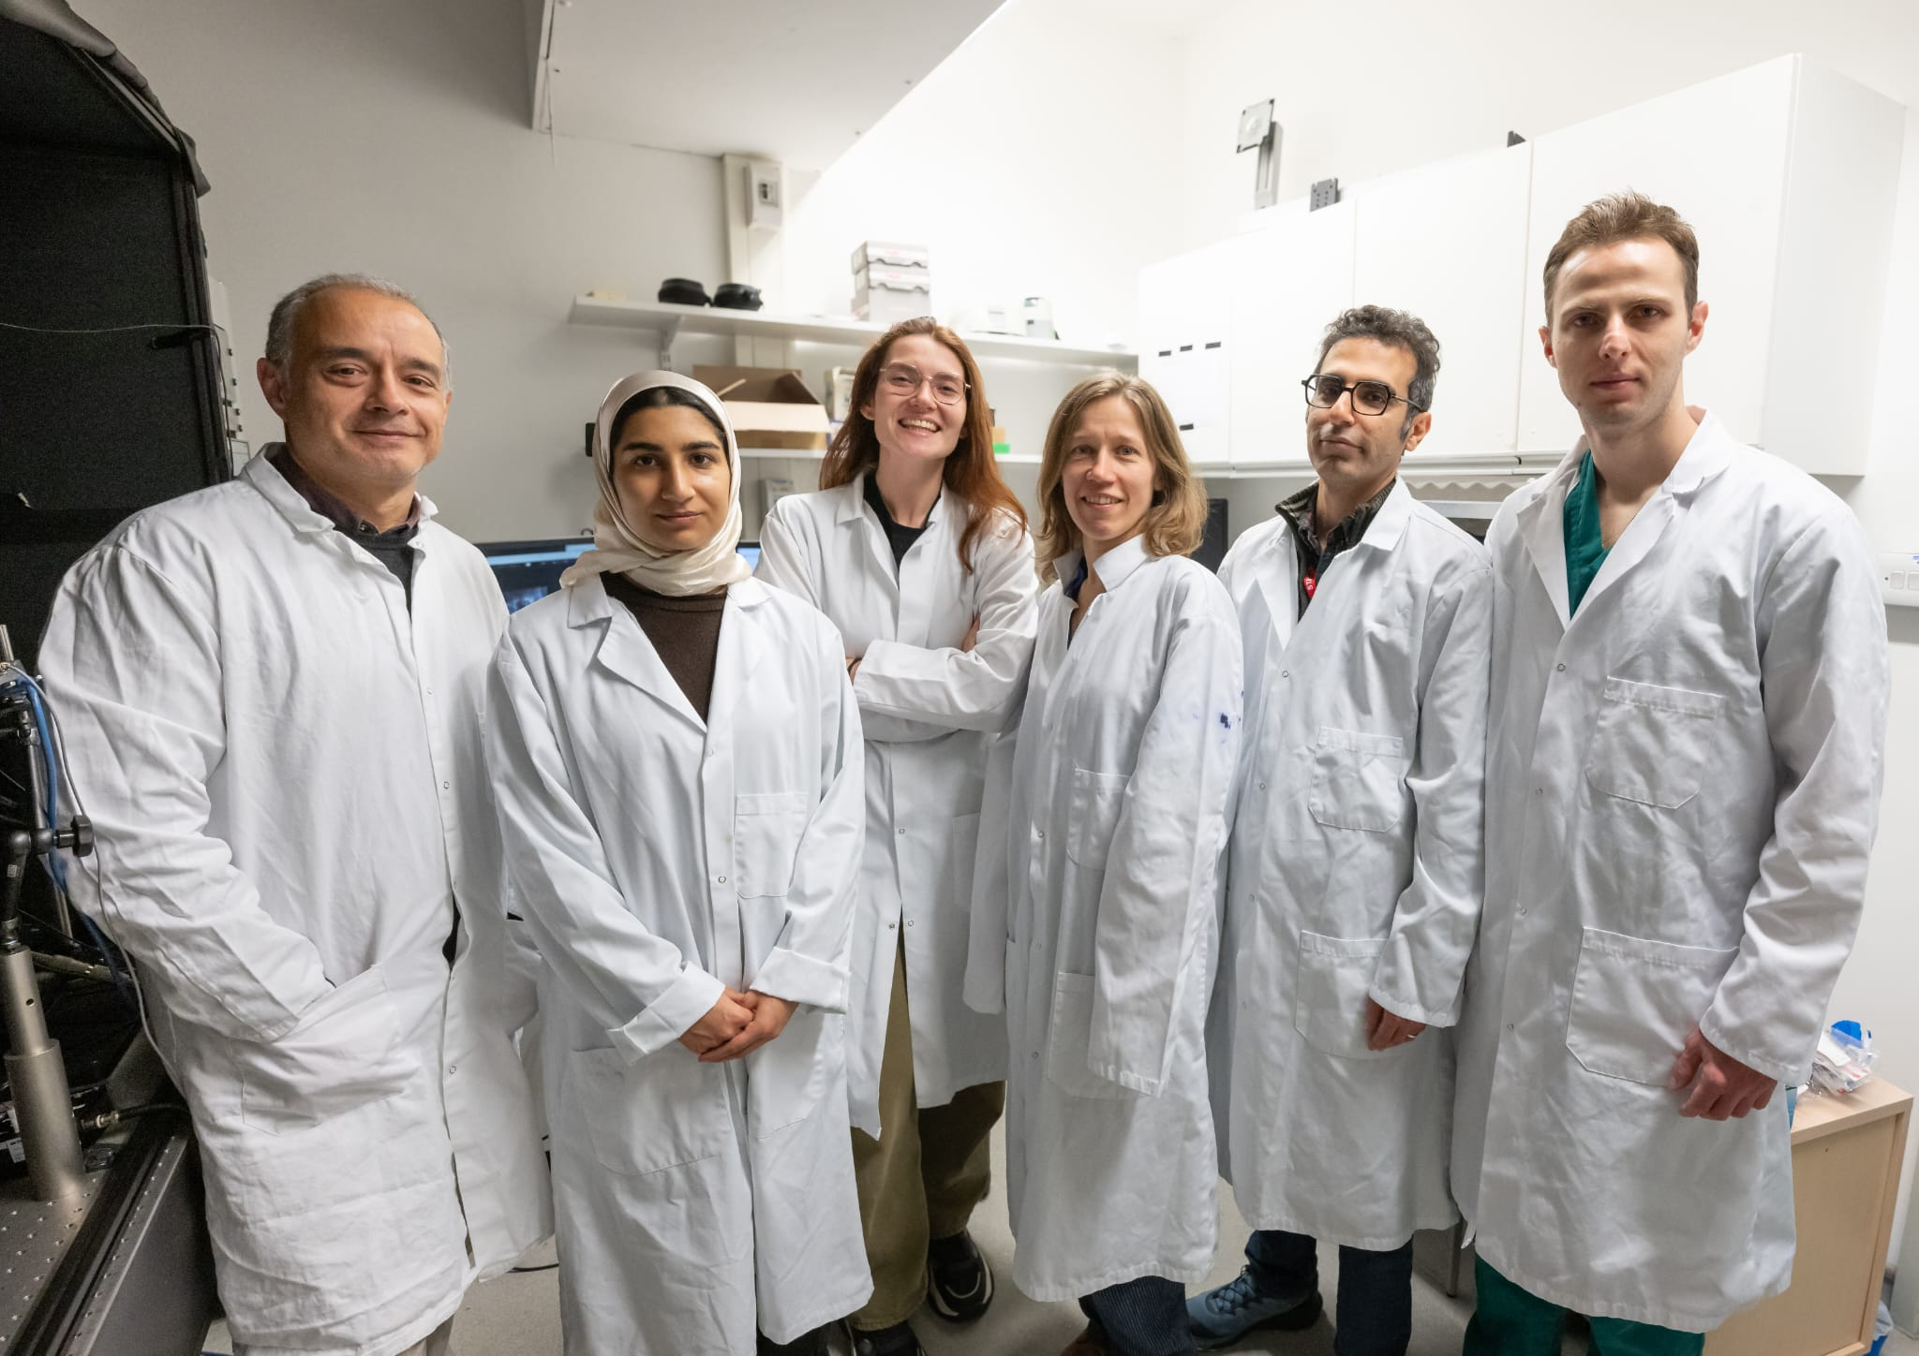
Alejandra Carriero
Third year PhD in Neuroscience and AI
Research in sequential events and the emergence of intrinsic rewards (aka. What makes us like music? Are the parameters universal across species? Can this be generalised to AI?)
Lab tutor at the university for coding, statistics and neuroscience

Slide 25
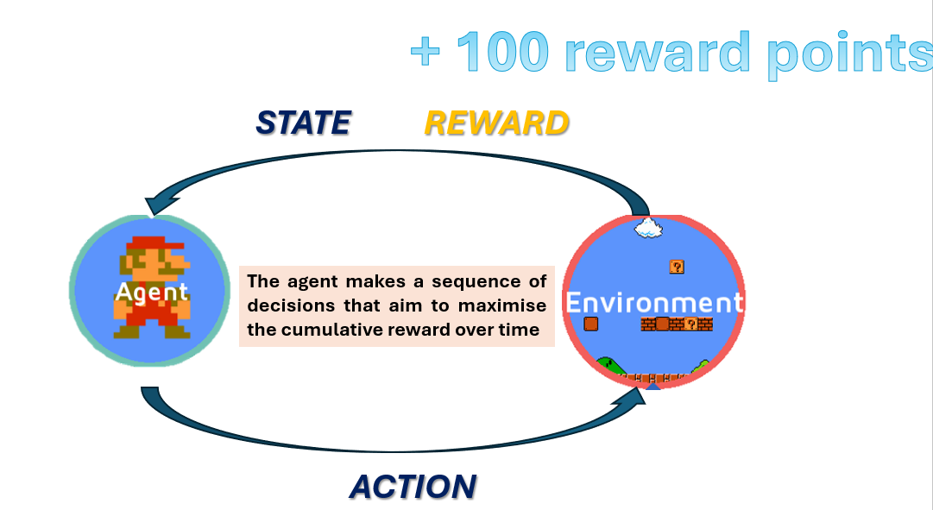
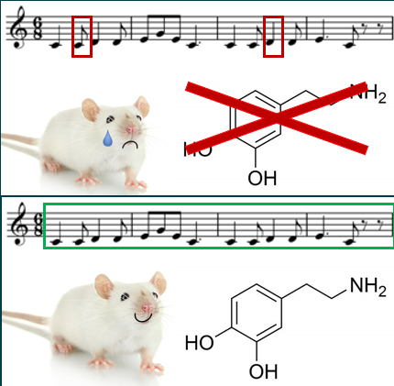
My research
As we interact with the world, we observe sequences of sensory inputs, and we output sequences of actions.
Some of these sequences (like music, or dancing, or watching a movie) are very nice (rewarding). The rewarding part is not the individual event (like a note), but the whole sequence.
What makes these sequences rewarding? What can AI learn from the way the brain processes these sequences?

Slide 26
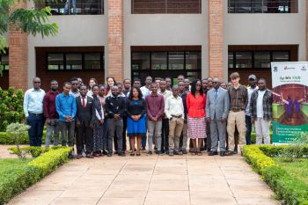
This course

Slide 27
What to expect
Working with hardware and making data logging devices
Modelling datasets that you have all made
Building classifiers/ prediction models based on this

Slide 28
What not to expect
We are providing the foundations, rather than making experts in 2 weeks
The datasets we make will not be the finished product!

Slide 29
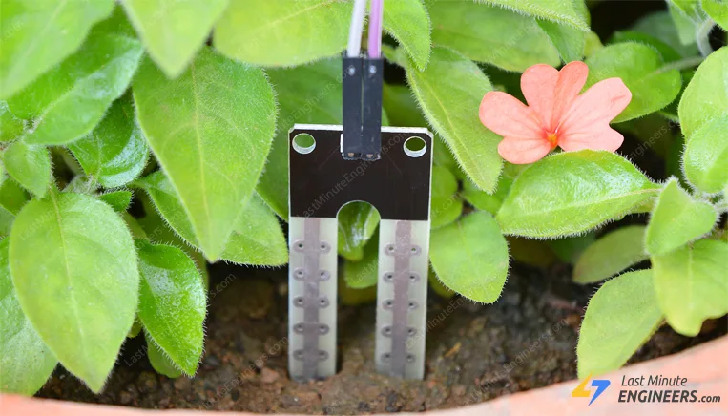
Day 2 (Tuesday)
Data sets and uses of doing it yourself
Introductions to electronics
The devices
The sensors

Slide 30
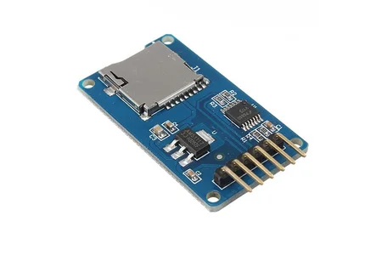
Day 3 (Wednesday)
Writing to storage devices
What data formats are best for different types of data
Working with memory constraints
Making good data sets

Slide 31
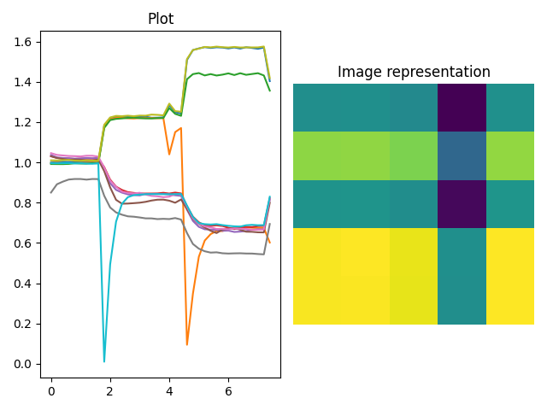
Day 4 (Thursday)
Data visualisation techniques
Uploading your datasets to the internet

Slide 32
Day 5 (Friday)
Field day gathering datasets
A bit on running ML on devices

Slide 33
Day 6 (Monday)
Regression models

Slide 34
Day 7 (Tuesday)
Classification

Slide 35
Day 8 (Wednesday)
Neural models

Slide 36
Day 9 (Thursday)
Augmentation of datasets
Scaling data
Dimensionality reduction

Slide 37
Day 10 (Friday)
Interesting AI
Presentations of projects

Slide 38
Labs

Slide 39
How the labs will work
Some labs will have worksheets
Some will have instructions
For both we will be roaming about to answer questions and checking in with you in the class - but these are labs, not lectures!

Slide 40
Best resources
The internet! (Stack overflow, python documentation, adafruit learn)
Eachother! Talk to each other and work together!

Slide 41
Download these softwares
Over lunch download the following softwares
Vscode - https://code.visualstudio.com/
Thonny IDE - https://thonny.org/

Slide 42
Schedule

Slide 43
Timetable | Mon | Tue | Wed | Thu | Fri | Sat | Sun | Mon | Tue | Wed | Thu | Fri
Lecture (1.5 hours) | 11:00am | 10:30am | 10:30am | 10:30am | 10:30am |  |  | 10:30am | 10:30am | 10:30am | 10:30am | 10:30am
Practical (2 hours) | 13:00pm | 13:00pm | 13:00pm | 13:00pm | 13:00pm |  |  | 13:00pm | 13:00pm | 13:00pm | 13:00pm | 13:00pm
Time table

Slide 44
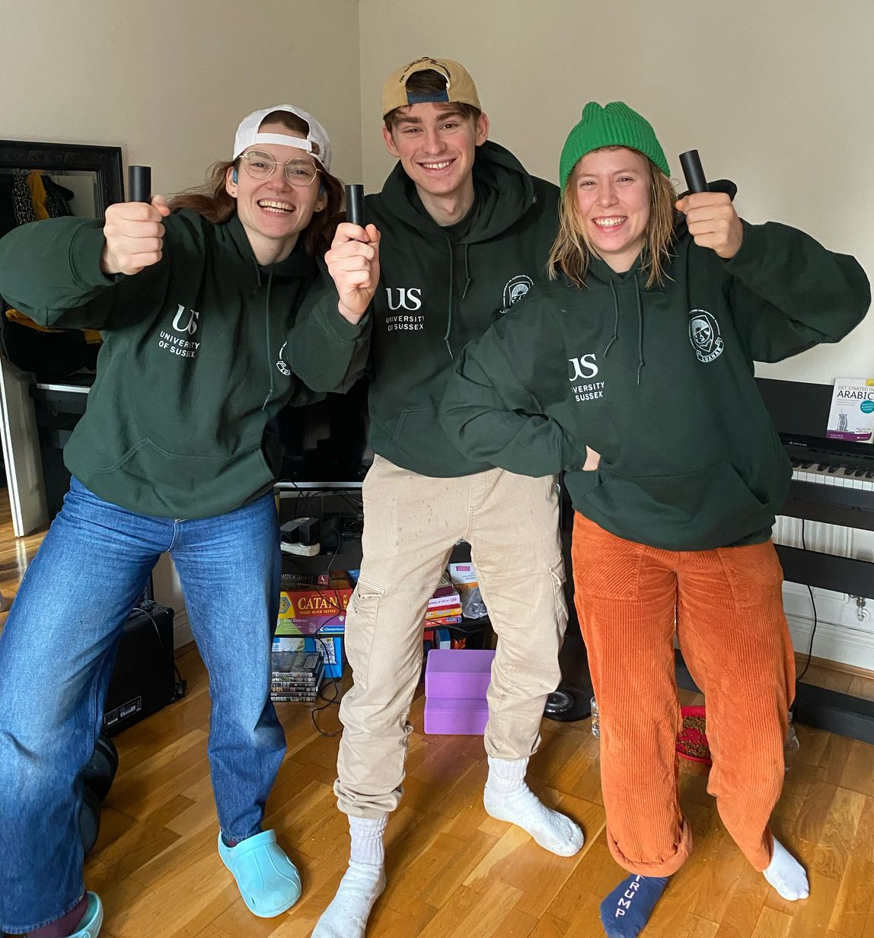
We look forward to working with you!

